Slide 1
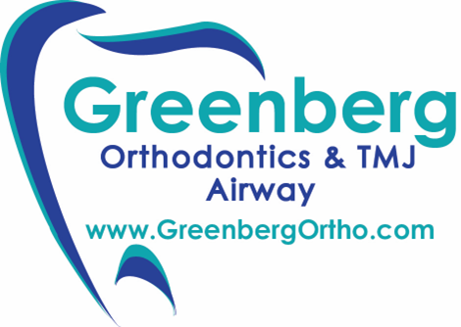
Dr. Vickie S. Greenberg
Sleep Disorders & You
Noon hour Health Lecture Huntington Hospital

Slide 2
Dr. Vickie S. Greenberg
www.GreenbergOrtho.com
Noon hour Health Lecture Huntington Hospital

Slide 3
Dr. Vickie S. Greenberg
Board Certified Orthodontist practicing for over 25 years.
Elite Provider of Invisalign®
Member of American Academy of Dental Sleep Medicine & the Fotona Light Walker Group
Has been published in the CDA Dental Journal.

Slide 4
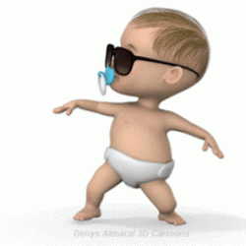
Dr. Vickie S. Greenberg

Slide 5
Dr. Vickie S. Greenberg
Using a natural approach, we treat:
TMJ Pain & Clicking
Airway
Grinding

Slide 6
Dr. Vickie S. Greenberg
Not Your Typical Orthodontist
Don’t Like Surgeries
Don’t Like Toxins, Medications or Drugs
Don’t Like Pulling Teeth

Slide 7
Dr. Vickie S. Greenberg
A Holistic Doctor Who Likes to Preserve The Natural Beauty of Your Face, Jaws, Teeth and Body

Slide 8
We offer surgical-case results with non-surgical treatments

Slide 9


Slide 10
Dr. Vickie S. Greenberg
AIRWAY
Obstruction due to tongue, palate, uvula and tonsils can cause breathing & sleep issues.

Slide 11
Dr. Vickie S. Greenberg
TMJ
Head, jaw, face, neck, shoulder & back pain, tension or fatigue. Tinnitus, clicking, locking jaw. Dizziness & tingling on the fingertips. Uncomfortable bite.

Slide 12
Dr. Vickie S. Greenberg
GRINDING
Teeth worn down & cracked. Broken crowns or fillings
Gum recession.

Slide 13

Dr. Vickie S. Greenberg

Slide 14
Do you have any of the following concerns regarding your airway?
Difficulty breathing through the nose / Mouth breathing
Snoring
Snoring interrupted by brief periods and then followed by gasping for air or wheezing
Difficulty breathing while sleeping
Waking up with shortness of breath
Tired during the day
Nasal obstruction
Tonsils enlarged
Adenoids enlarged
Sleepiness when driving
Deviated septum

Slide 15
How sleepy are you?
Are you sleepy when…
Sitting and reading
Watching TV
Sitting inactive in a public place (e.g., a theater or a meeting)
As a passenger in a car for an hour without a break
Lying down to rest in the afternoon
Sitting and talking to someone
Sitting quietly after lunch without alcohol
In a car, while stopped for a few minutes in traffic

Slide 16
Have you had a Sleep Study Test done?
Has a doctor recommended a CPAP Machine for you?
Do you have an oral appliance for snoring or grinding?

Slide 17
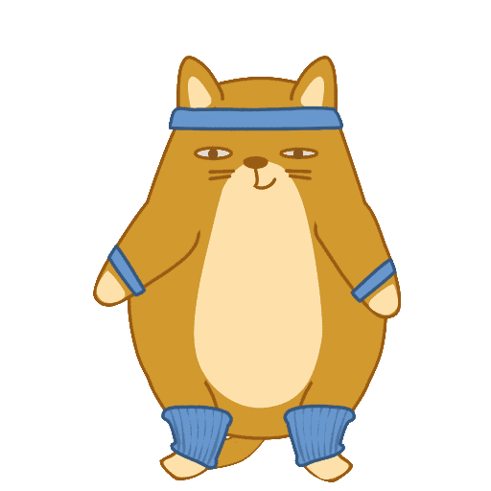

Slide 18


Slide 19
Do you have any of the following concerns regarding your TMJ?
Crackling sounds in jaw
Clicking or popping sounds in jaw
Ear ringing (Tinnitus)
Earaches, pain / tension around the ear
Jaw pain, tension and/or tiredness
Facial pain / tension
Head pain / tension
Neck pain / tension
Shoulder pain / tension
Back pain / tension
Locked jaw
Limited jaw motion
Uncomfortable, unstable and/or changing bite
Numbness or tingling feeling in the fingers
Dizziness or fainting

Slide 20
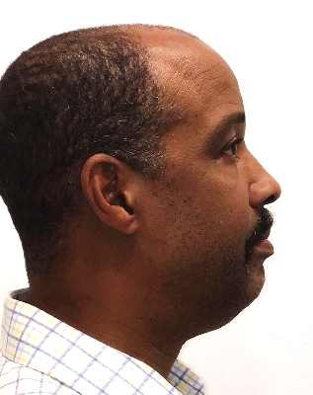
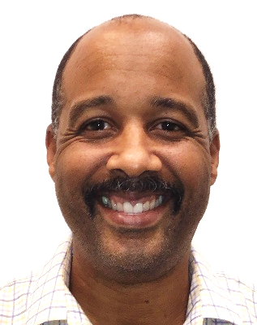
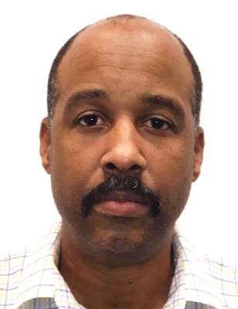

Facial PHOTOGRAPHS
Upper and lower jaw bones in all 3 dimensions
Lips- Competent or apart?
Head Position- Tilted up or down?

Slide 21
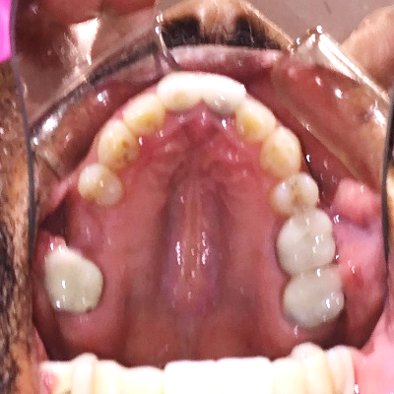
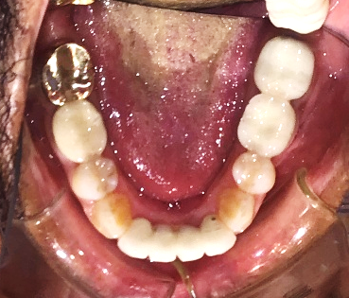
Occlusal PHOTOGRAPHS
Arch Shape
Arch Size
Arch Length

Slide 22
Occlusal PHOTOGRAPHS
Teeth Angulations
Tongue Tie
Tongue Size

Slide 23
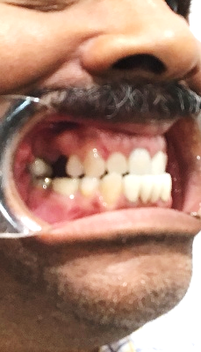
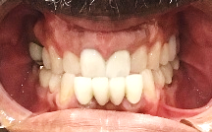
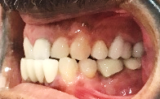
INTRAORAL PHOTOGRAPHS
Bite- Malocclusion
Asymmetry- Midline
Overlap- Vertical & Horizontal

Slide 24
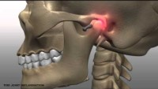

Slide 25
This is how we help with
airway, tmj & grinding
RELEASE & SETTLE THERAPY™

Slide 26


Slide 27
  Our “Release and Settle Therapy™” improves and increases the airway.
  This option is ideal for athletes and singers.

Slide 28
The “Release Therapy™” is designed to reshape your upper jaw within the first few weeks of treatment increasing your airway and releasing your lower jaw.

Slide 29
The “Settle Therapy™” is designed to settle your bite into a more comfortable, and natural position.

Slide 30
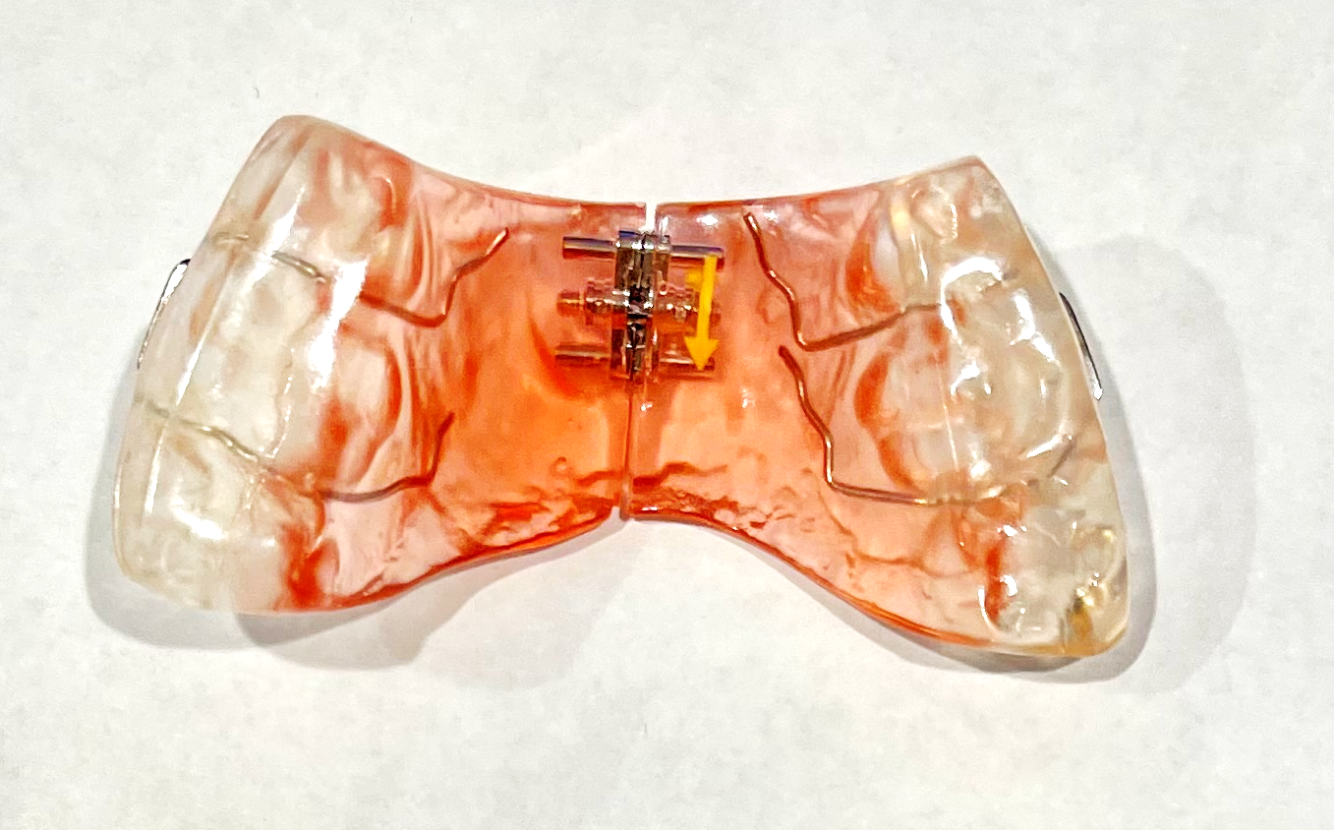
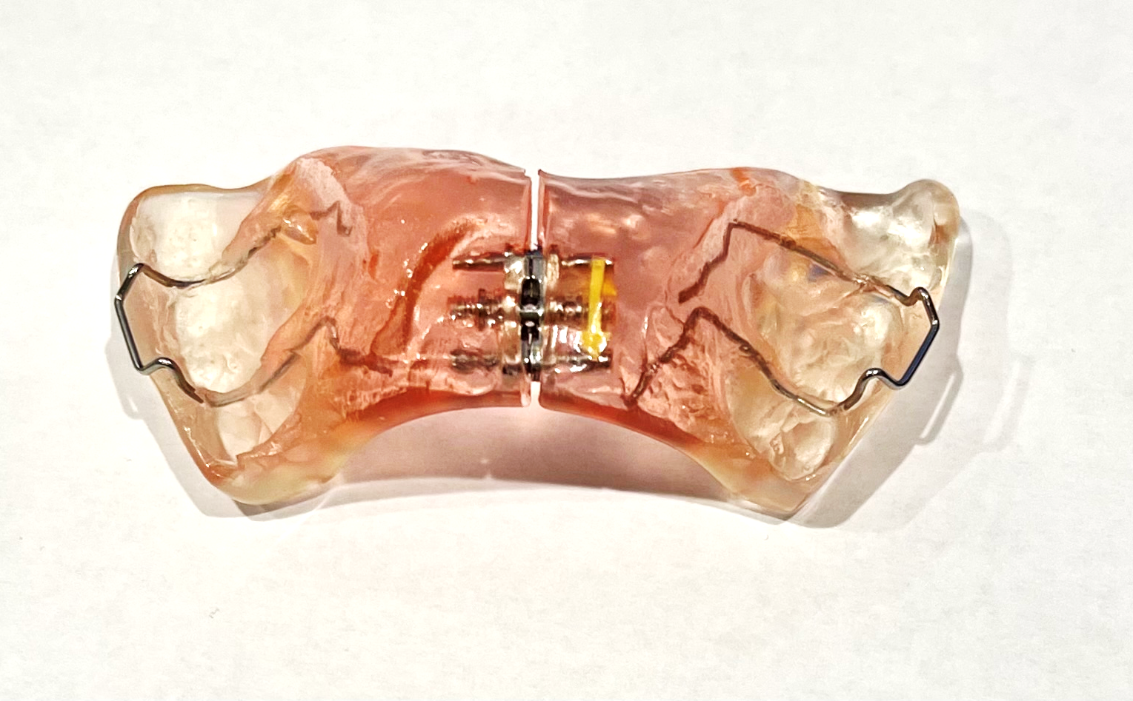
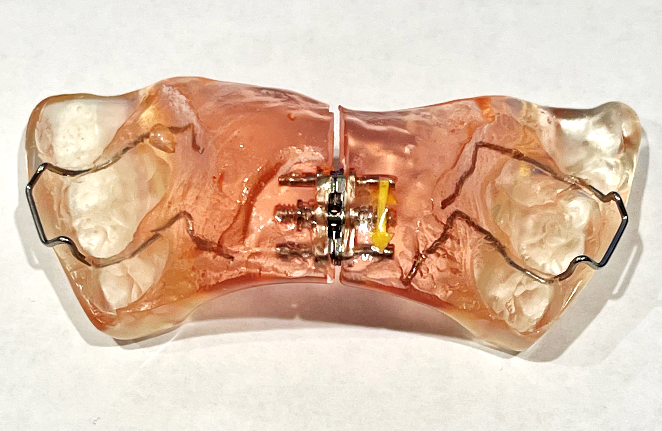
Release Therapy™
UPPER RESHAPING APPLIANCE
Moves the upper jaw bone in all 3 dimensions
releases the lower jaw &
increases the airway

Slide 31
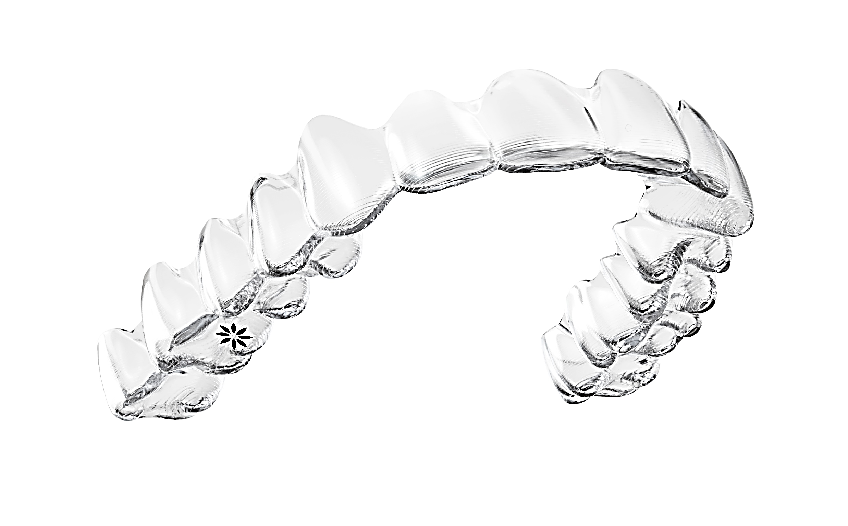
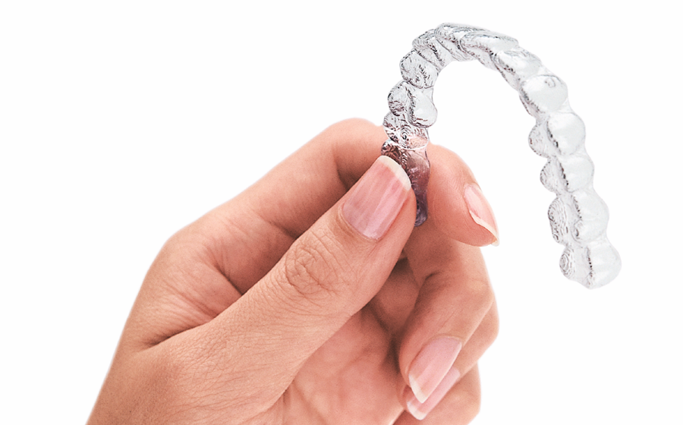
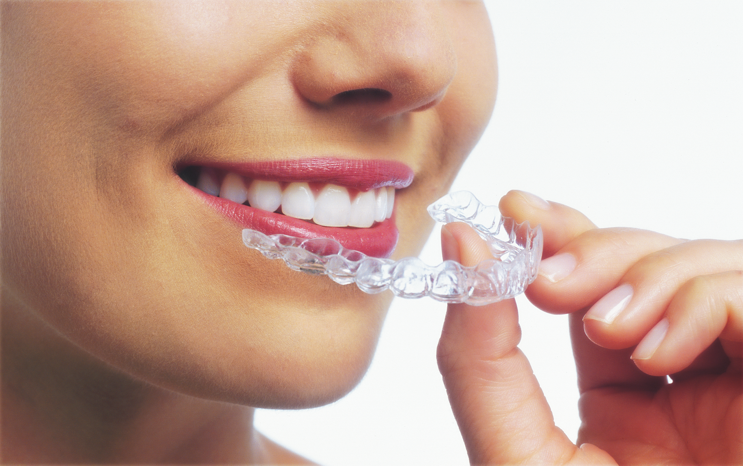
Settle Therapy™
clear aligners
Settle the teeth into a healthy and comfortable position

Slide 32

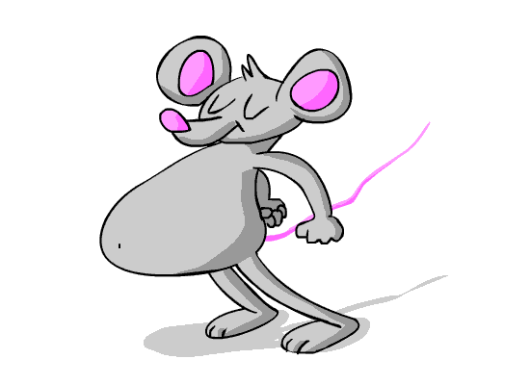

Slide 33
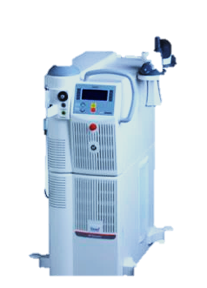
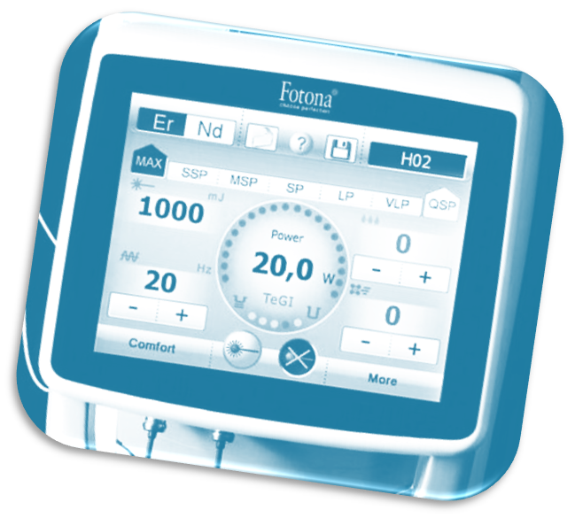
NightLase®
  A safe laser therapy for patients that are CPAP/ Oral appliance intolerant.

Slide 34
  NightLase® Therapy firms up the flabby tissue with a gentle tightening effect.

Slide 35
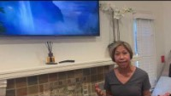

Slide 36
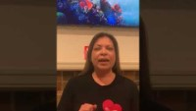

Slide 37

DO YOU
HAVE
ANY QUESTIONS?

Slide 38
THANK YOU
I hope to see you soon!

Slide 39
Dr. Vickie S. Greenberg
www.GreenbergOrtho.com
Phone (626) 798-7645
Info@GreenbergOrtho.com

